Slide 1
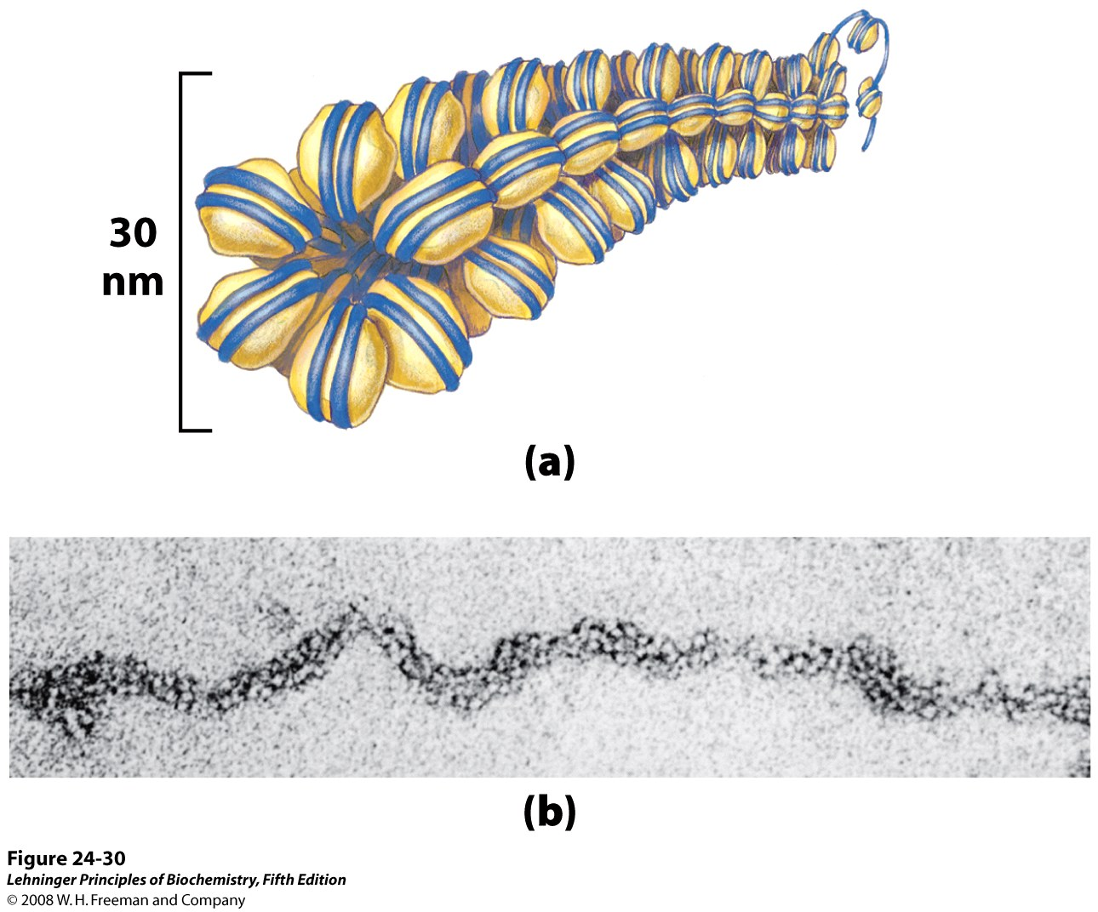
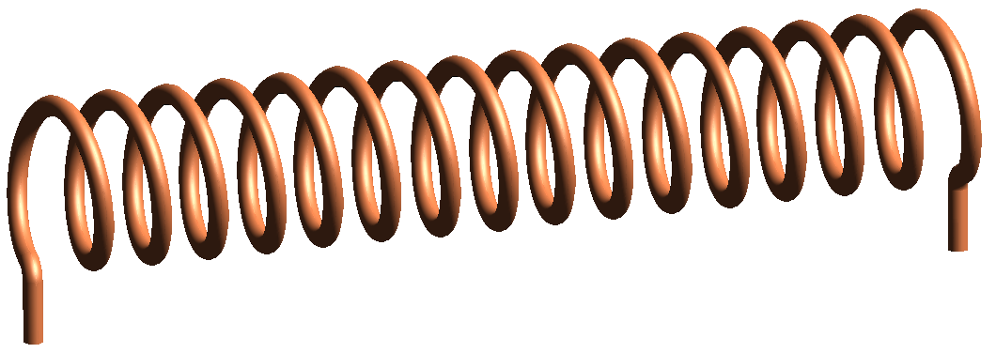
Higher order organization of nucleosomes
Lecture - 6

Slide 2
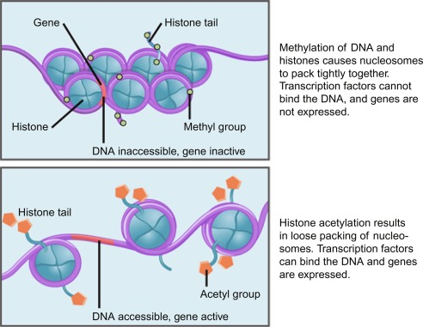
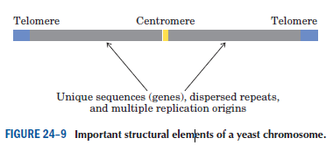
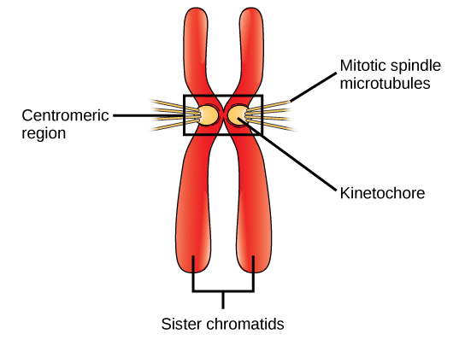
Heterochromatin vs euchromatin

Slide 3
Genome size and complexity of organism

Slide 4
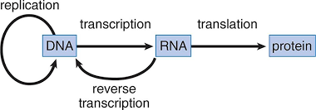
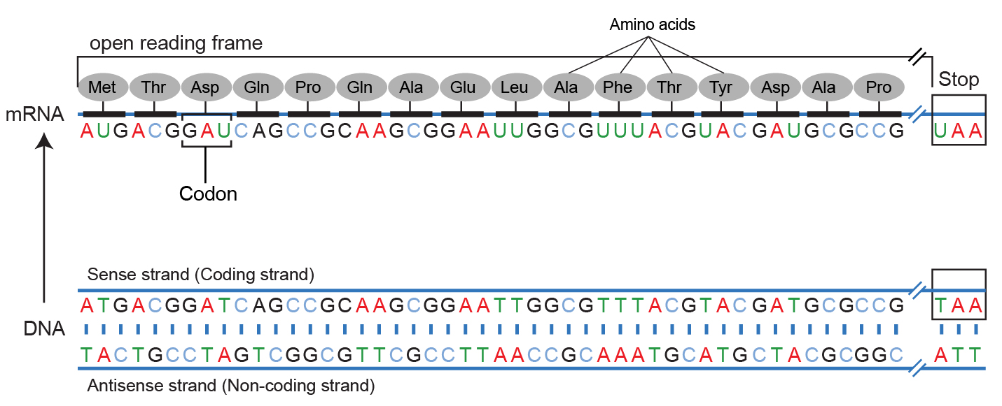
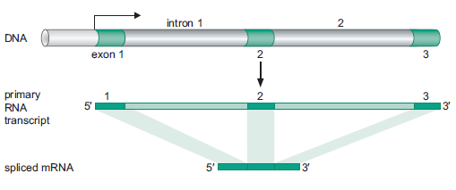
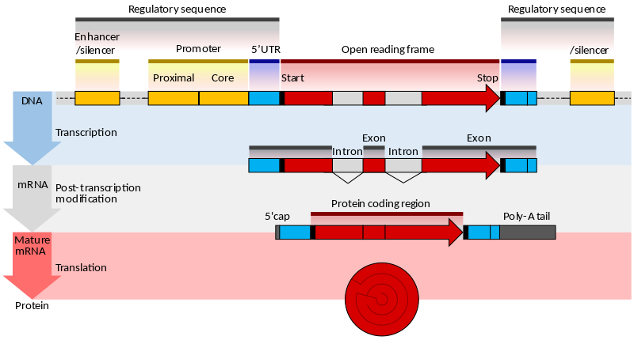
Gene: The functional region of a chromosome/DNA
A region in DNA that encodes a gene product, either RNA or protein

Slide 5
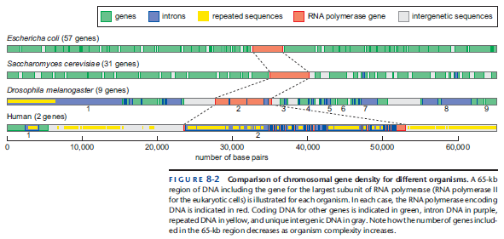
Gene density and organismal complexity
More Complex Organisms Have Decreased Gene Density
Two factors contribute to the decreased gene density observed in eukaryotic cells: a) increases in gene size and b) increase in the DNA between genes, called intergenic sequences.

Slide 6
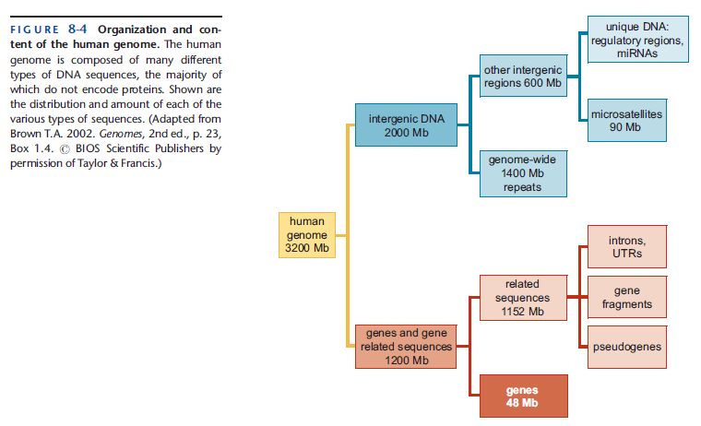

Slide 7
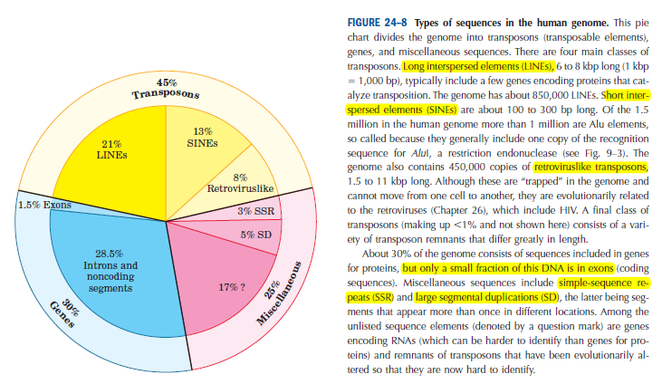
Types of sequence in human genome

Slide 8
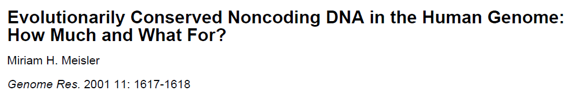
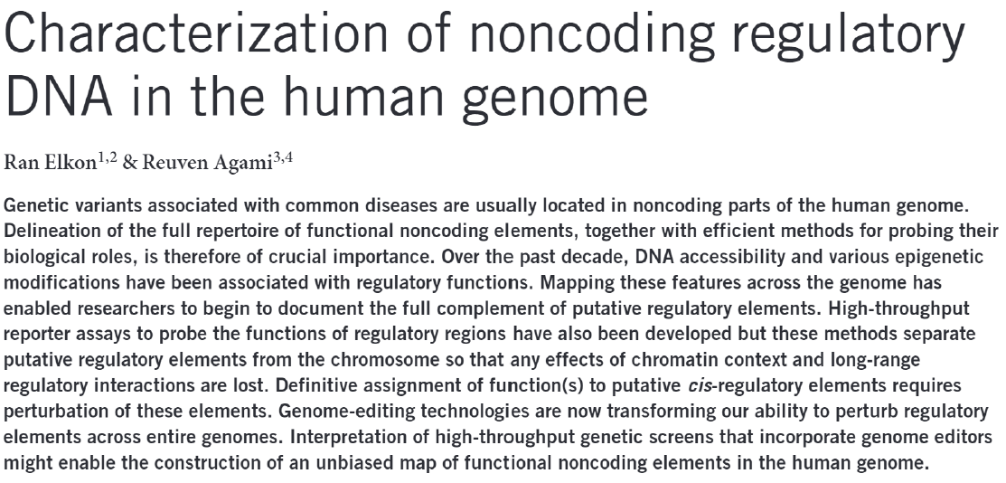
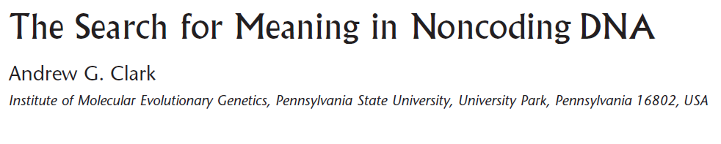
Genome Res. 2001 Aug;11(8):1319-20

